Slide 1
ASSIGNMENT -1
MACHINE LEARNING REPORT
SUBMITTED BY : NAME :- MOURYA B D
USN :- ENG19CS0188
SECTION :- ' D '
SUBMISSION DATE : 31/8/2021
SUBMITTED TO: CVSN REDDY SIR

Slide 2

Content
Machine Learning introduction
Machine Learning types ( Supervised ,Unsupervised and Reinforcement learning)
Data Warehouse and Data Mining
Machine Learning algorithms with implementation
Linear regression
Logistic regression
Decision tree
Random Forest
KNN
SVM
Application of Machine Learning
In Healthcare
In Telecom
Conclusion

Slide 3
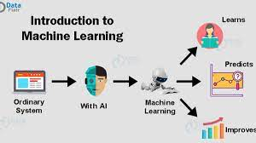
Machine Learning
INTRODUCTION:
Machine learning is a branch of artificial intelligence, concerned with the design and development of algorithms that allow computers to evolve behaviors based on empirical data.
The algorithms are 'trained' to find patterns and features in massive amounts of data in order to make decisions and predictions based on new data.
They uses statistical techniques to give computer systems the ability to learn with Data, without being explicitly programmed

Slide 4
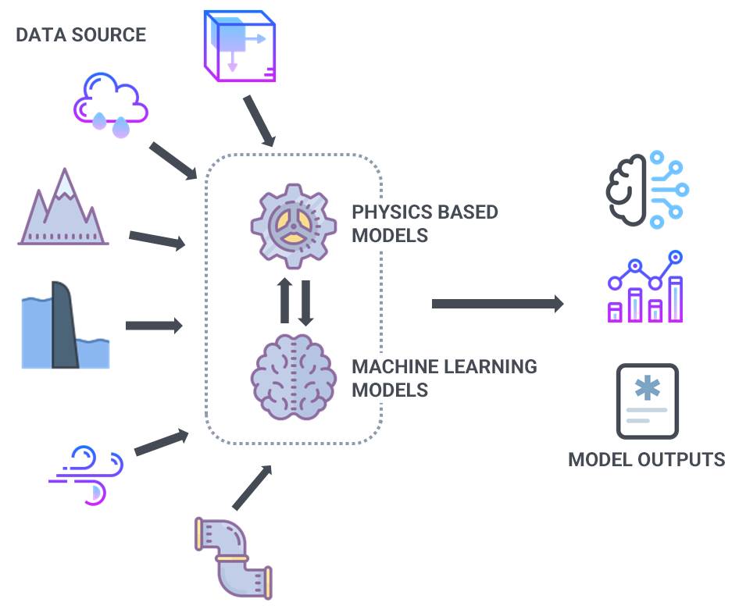
Machine Learning

Slide 5
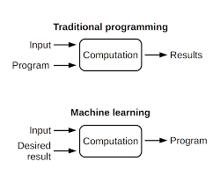
Traditional Programming and Machine Learning

Slide 6
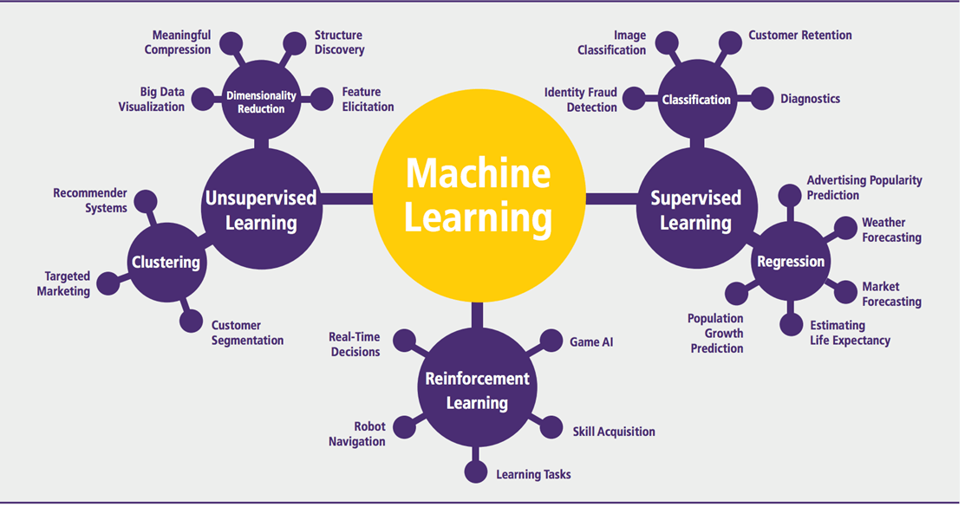
Machine Learning Types
There are 3 main types of machine learning they are :
Supervised learning
Unsupervised learning
Reinforcement learning

Slide 7
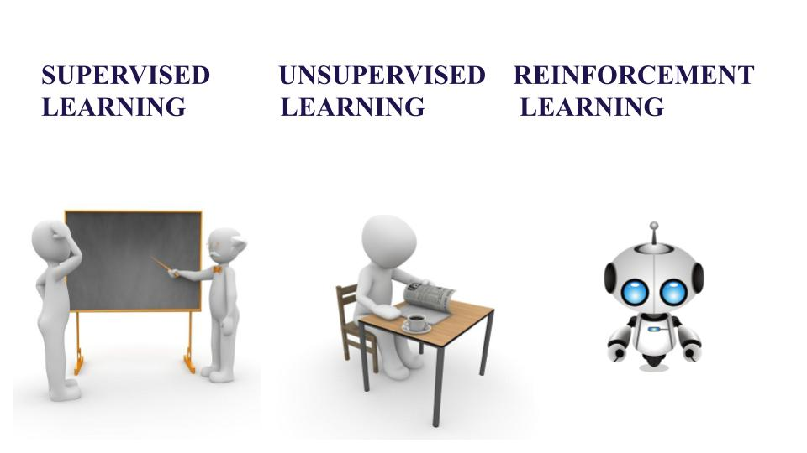
Supervised machine learning
Supervised learning is the machine learning task of learning a function that maps an input to an output based on example of input-output pairs.
This algorithm analyzes the training data and produces a function, which can be used for mapping new examples.
It concludes a function from labeled training data consisting of a set of training examples.
It is nothing but learning from someone ,for example , student learns from teachers .

Slide 8

Supervised machine learning

Slide 9
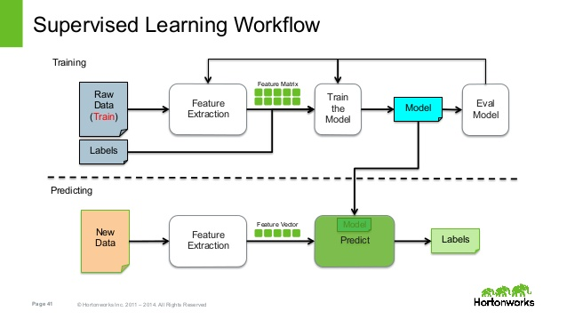
Supervised machine learning

Slide 10
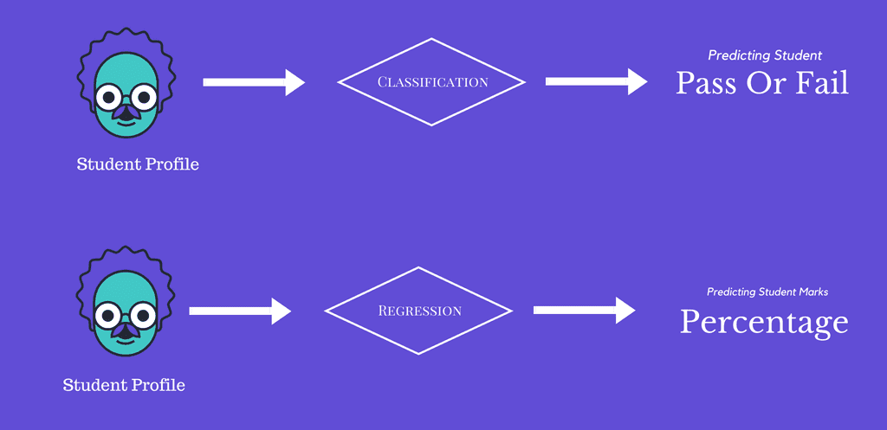
Supervised Machine Learning Types are :
Classification
Regression

Slide 11
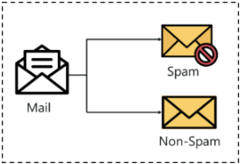
Classification
Classification in machine learning is a supervised learning approach in which the computer program learns from the data given to it and make new observations or classifications.
Classification is a process of categorizing a given set of data into classes, It can be performed on both structured or unstructured data.
The classification predictive modeling is the task of approximating the mapping function from input variables to discrete output variables. The main goal is to identify which class/category the new data will fall into.

Slide 12
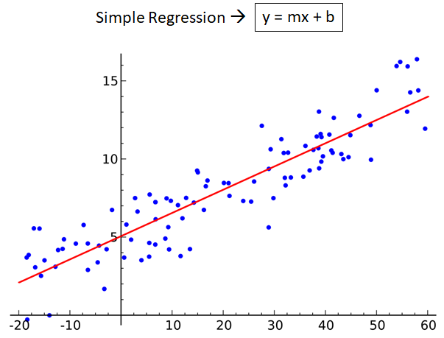
Regression
Regression means to predict the value using the input data. Regression models are used to predict a continuous value.
Regression models differ based on the kind of relationship between dependent and independent variables.
The regression model is employed to create a mathematical equation that defines y as operate of the x variables. This equation may be accustomed to predict the end result “y” on the ideas of the latest values of the predictor variables x.

Slide 13
Unsupervised Machine Learning
Unsupervised machine learning ingests unlabeled data—lots and lots of it—and uses algorithms to extract meaningful features needed to label, sort, and classify the data in real-time, without human intervention.
The model learns through observation and finds structures in the data. Once the model is given a dataset, it automatically finds patterns and relationships in the dataset by creating clusters in it.

Slide 14
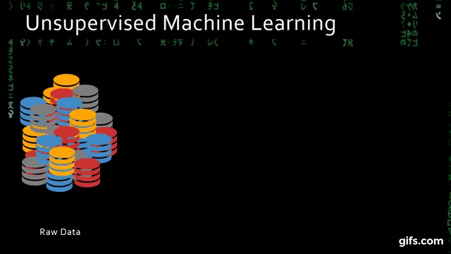

Slide 15
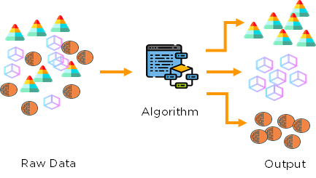
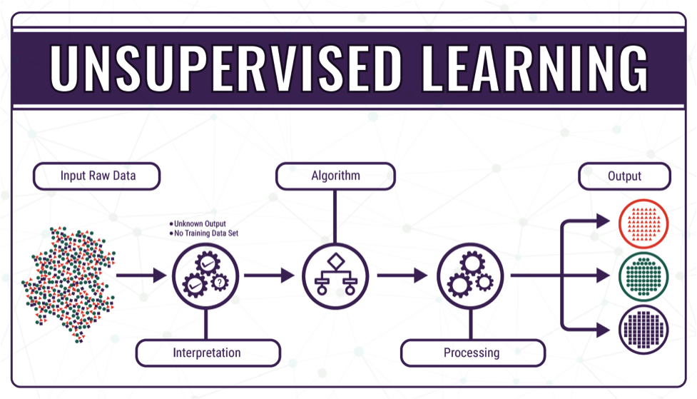
Unsupervised Machine Learning

Slide 16
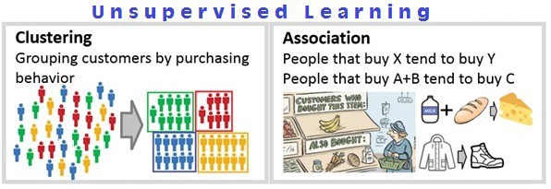
Unsupervised Machine Learning Types
Clustering
Association

Slide 17
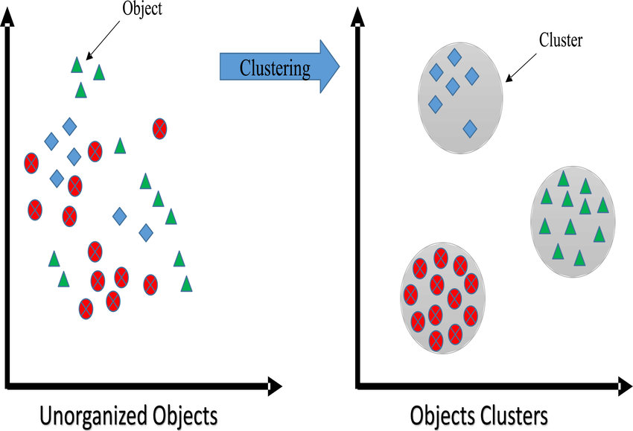
Clustering
A way of grouping the data points into different clusters, consisting of similar data points. The objects with the possible similarities remain in a group that has less or no similarities with another group.
It does by finding some similar patterns in the unlabelled dataset such as shape, size, color, behavior, etc., and divides them as per the presence and absence of those similar patterns.

Slide 18
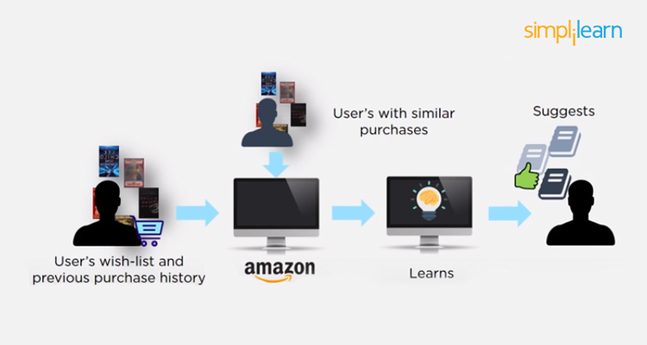
Association
Association learning is a rule based machine learning and data mining technique that finds important relations between variables or features in a data set.
This unsupervised technique is about discovering interesting relationships between variables in large databases and try showing related items/methods/process with respect to the given input.
For example, people that buy a new home most likely to buy new furniture.

Slide 19

Reinforcement machine learning
It is the ability of an agent to interact with the environment and find out what is the best outcome. It follows the concept of hit and trial method.
The agent is rewarded or penalized with a point for a correct or a wrong answer, and on the basis of the positive reward points gained the model trains itself. And again once trained it gets ready to predict the new data presented to it.

Slide 20
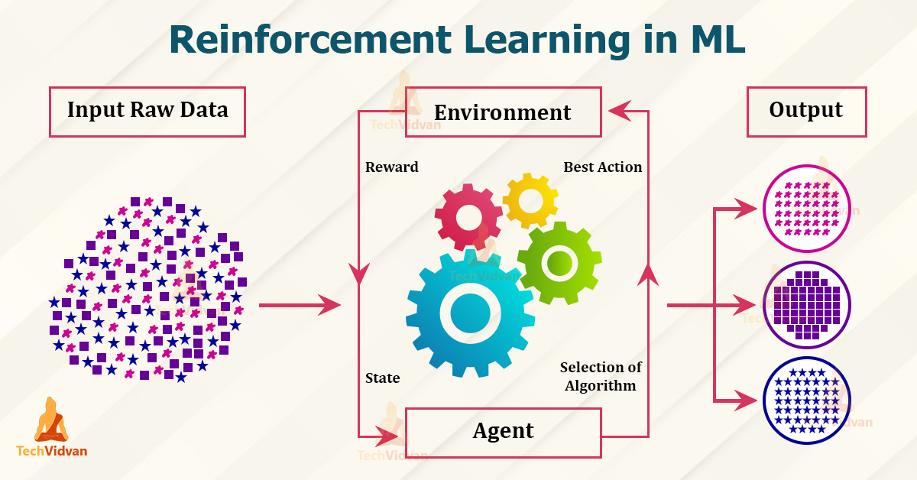

Slide 21
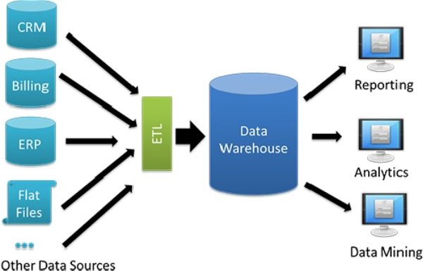
Data Warehouse
A data warehouse is a system that aggregates data from different sources into a single, central, consistent data store to support data analysis, data mining and artificial intelligence.
A data warehouse was hosted on a mainframe computer,and its functionality was focused on extracting data from other sources, cleansing and preparing the data, and loading and maintaining the data in a relational database.
But recently ,it can be hosted on a dedicated appliance or in the cloud, and most data warehouses have added analytics capabilities and data visualization and presentation tools.

Slide 22
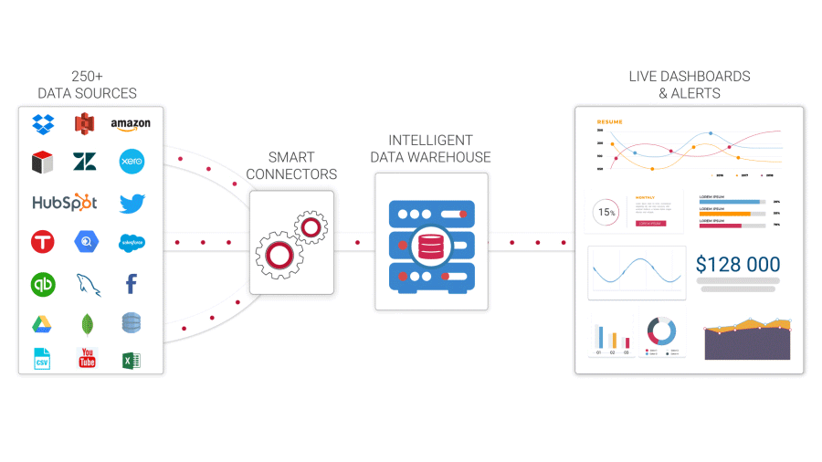
Data Warehouse

Slide 23
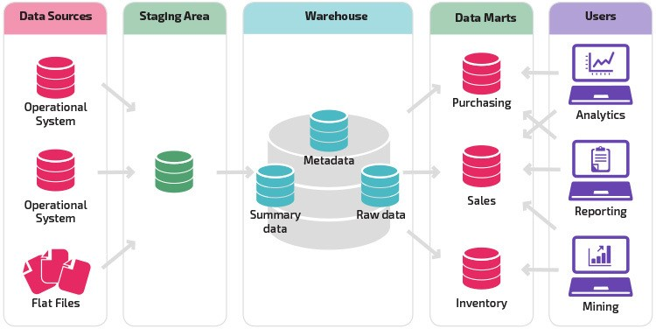
Architecture of Data Warehouse

Slide 24
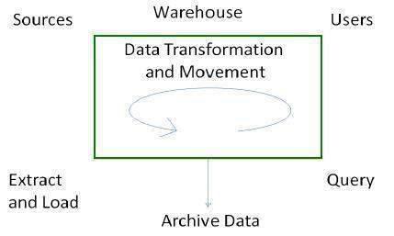
Process of Data Warehouse
There are mainly four processes in data warehousing , they are:
Extract and load the data.
Cleaning and transforming the data
Backup and archive the data.
Query Management Process

Slide 25
Process of Data Warehouse
Extract and Load Process :- Data extraction takes data from the source systems,the information extracted from the external sources will be reconstructed.After extracting the data, it is loaded into a temporary data store where it is cleaned up and made consistent.
Cleaning and transforming the data :- Cleaning and transforming the loaded data helps speed up the queries.Transforming involves converting the source data into a structure.
Here is the list of steps involved in Cleaning and Transforming:-
Clean and transform the loaded data into a structure
Partition the data
Aggregation

Slide 26
Process of Data Warehouse
Backup and archive the data :- Backup is important to recover the data in the event of data loss, software failure, or hardware failure . Archiving involves removing the old data from the system in a format that allow it to be quickly restored whenever required. There is often a requirement to be able to do month-on-month comparisons for this year and last year. In this case, we require some data to be restored from the archive.
Query Management Process :- It consists of the following points
manages the queries.
helps speed up the execution time of queries.
directs the queries to their most effective data sources.
ensures that all the system sources are used in the most effective way.
monitors actual query profiles.

Slide 27
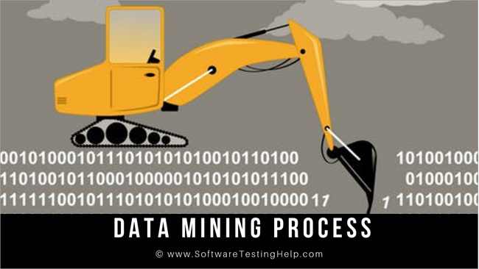
Data Mining
Data Mining is a process of discovering interesting patterns and knowledge from large amounts of data . It is the core process where a number of complex and intelligent methods are applied to extract patterns from data
Data Mining is carried using various techniques such as clustering, association, and sequential pattern analysis & decision tree.
The overall goal of data mining process is to extract information from a data set and transform it into an understandable structure for further use.

Slide 28
Process of Data Mining
Business understanding
Data understanding
Data preparation
Data transformation
Modelling
Evaluation
Deployment

Slide 29
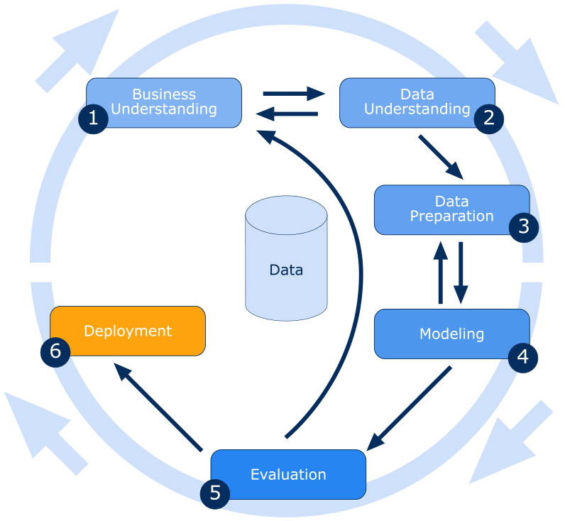
Process of Data Mining

Slide 30
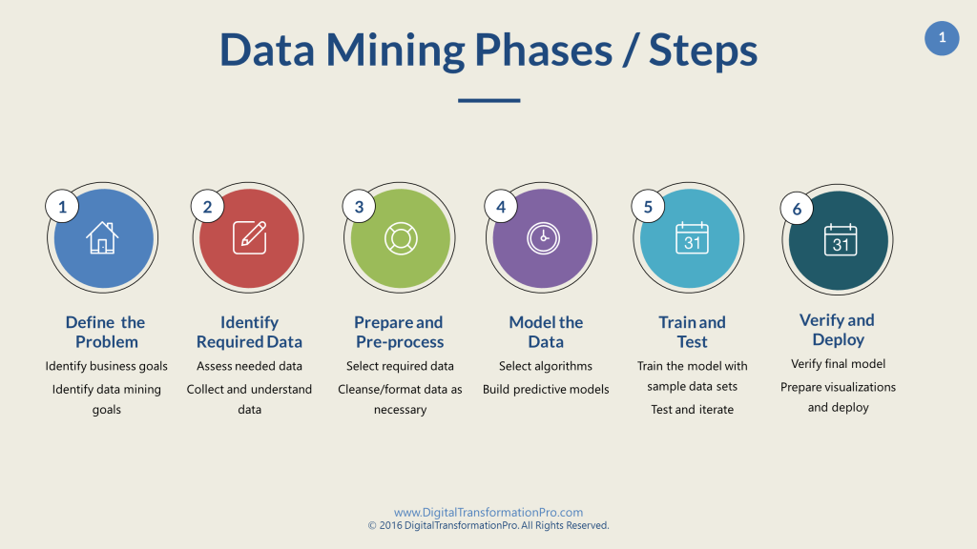
Process of Data Mining

Slide 31
Process of Data Mining
Business understanding :- In this phase, business and data-mining goals are established.First, we need to understand business and client objectives. we need to define what your client wants
Data understanding :- In this phase, sanity check on data is performed to check whether its appropriate for the data mining goals.First, data is collected from multiple data sources available in the organization.Next, the step is to search for properties of acquired data. A good way to explore the data is to answer the data mining questionsusing the query, reporting, and visualization tools.
Data preparation :- In this phase, data is made production ready.The data preparation process consumes about 90% of the time of the project.The data from different sources should be selected, cleaned, transformed, formatted, anonymized, and constructed.
Data transformation :- Data transformation operations change the data to make it useful and would contribute toward the success of the mining process.The transformations that can be applied are Smoothing,Aggregation,Generalization,Normalization and Attribute construction.

Slide 32
Process of Data Mining
Modelling :- In this phase, mathematical models are used to determine data patterns.Based on the business objectives, suitable modeling techniques should be selected for the prepared dataset.Create a scenario to test check the quality and validity of the model.Run the model on the prepared dataset.
Evaluation :-In this phase, patterns identified are evaluated against the business objectives.Results generated by the data mining model should be evaluated against the business objectives.Gaining business understanding is an iterative process. In fact, while understanding, new business requirements may be raised because of data mining.
Deployment :-In the deployment phase, you ship your data mining discoveries to everyday business operations.The knowledge or information discovered during data mining process should be made easy to understand for non-technical stakeholders.

Slide 33
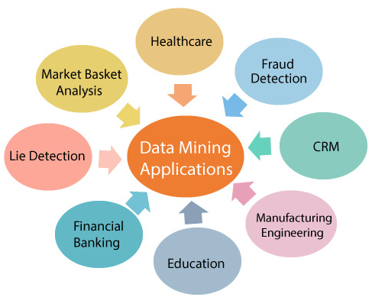
Application of Data Mining

Slide 34
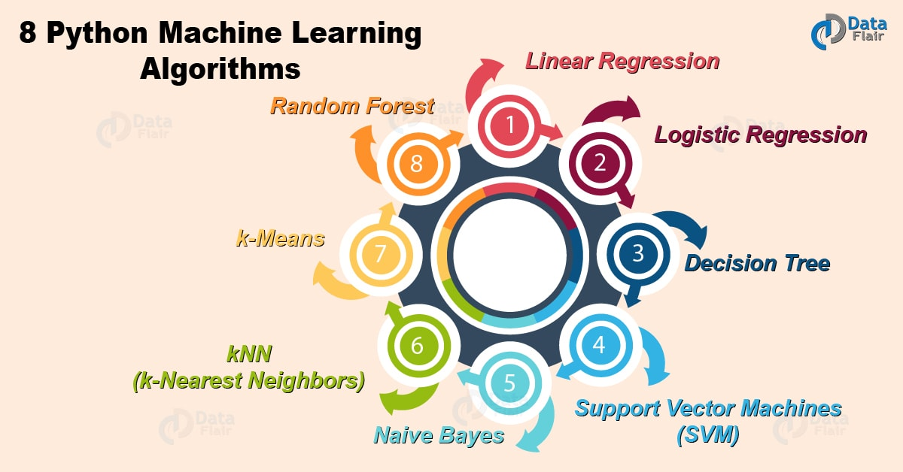
Machine Learning Algorithms

Slide 35
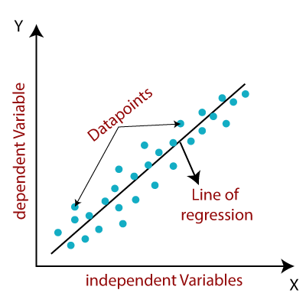
Linear Regression
It is used to estimate real values based on continuous variables or data. Here, we establish relationship between independent and dependent variables by fitting a regression line and represented by a linear equation Y= a *X + b
Let us understand by taking an example of weight prediction ,We give height and weight data to Linear regression algorithm and call the fit method,a model will be formed .
Then we will give a height to the model for which weight is to be predicted,and call the predict method ,we get the weight for the given height.

Slide 36
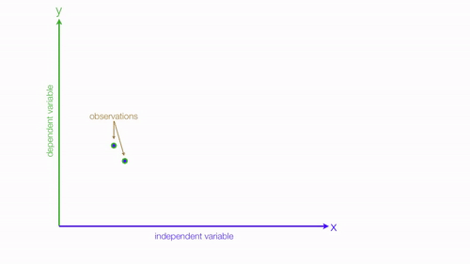
Linear Regression

Slide 37
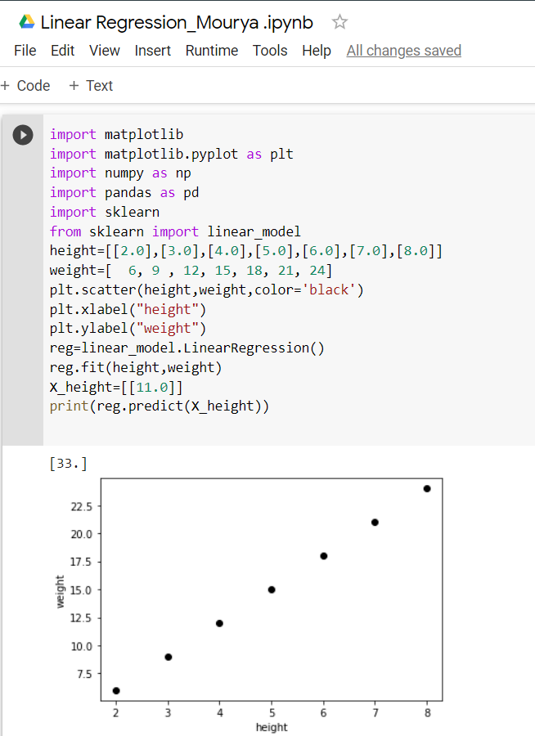
Implementation of Linear Regression
Here we have given height and weight value in such a way that the linear equation will be Y= 3 * X
The value of X (height) is 11.0
The predicted value of Y (weight) is 33

Slide 38
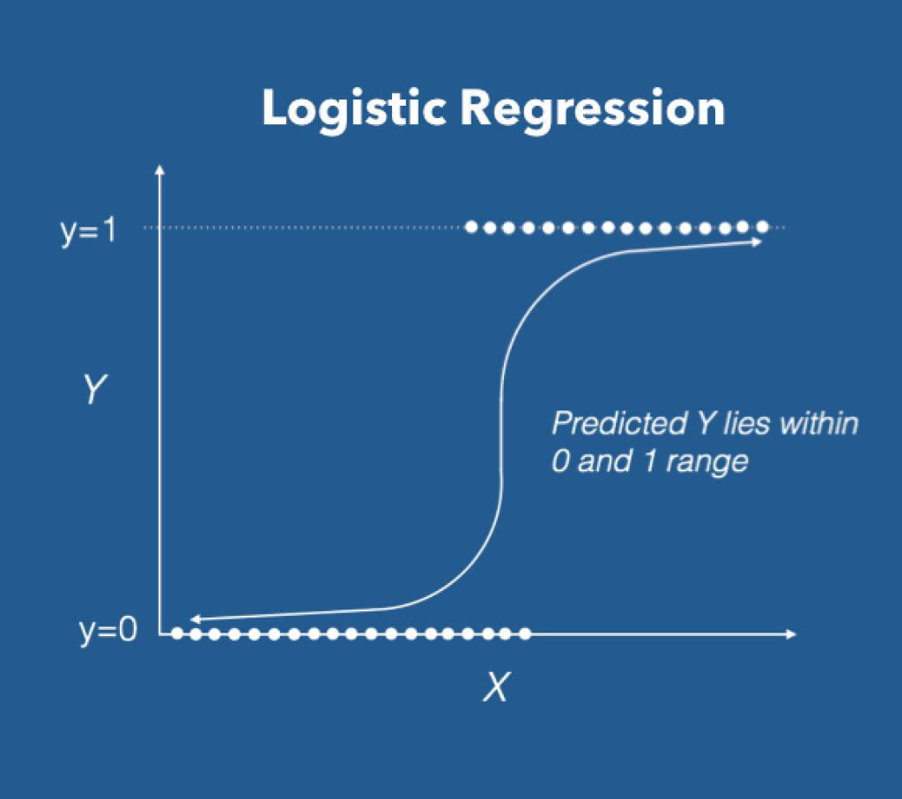
Logistic Regression
It is used to estimate discrete values like 0/1, yes/no, true/false based on given set of independent variables.
It predicts the probability of occurrence of an event by fitting data to a logit function , its output values lies between 0 and 1.
Let us understand by taking an example of pass/fail ,We give marks and value 0 if fail and 1 if pass , to Logistic regression algorithm and call the fit method,a model will be formed .
Then we will give a marks to the model for which pass/fail is to be predicted,and call the predict method ,we get the output.

Slide 39
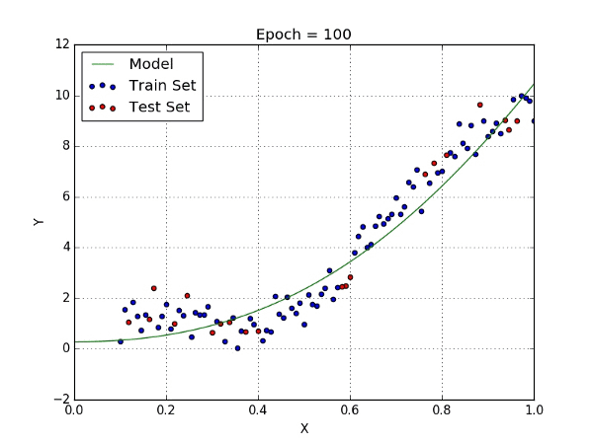
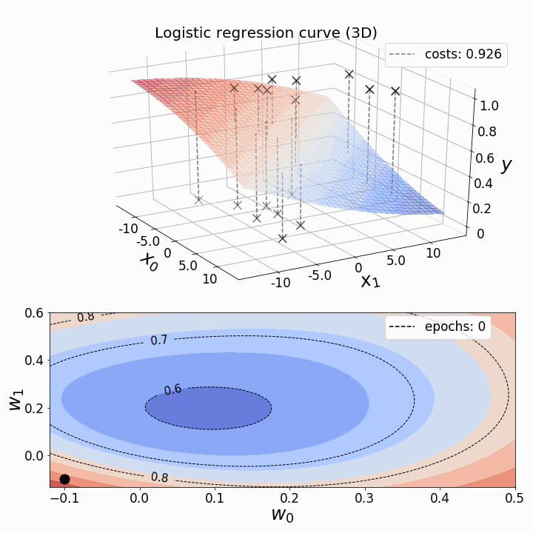
Logistic Regression

Slide 40
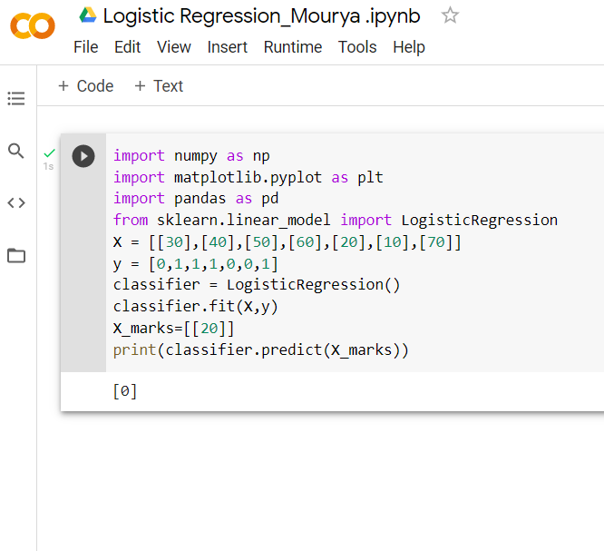
Implementation of Logistic Regression
First we'll call logistic regression algorithm ,then we give marks and its weight as the input .
The value of X( marks) is 20 .
The Predicted value of Y (Pass/Fail) is 0.
So if the marks is 20 then the student is said to Fail.

Slide 41
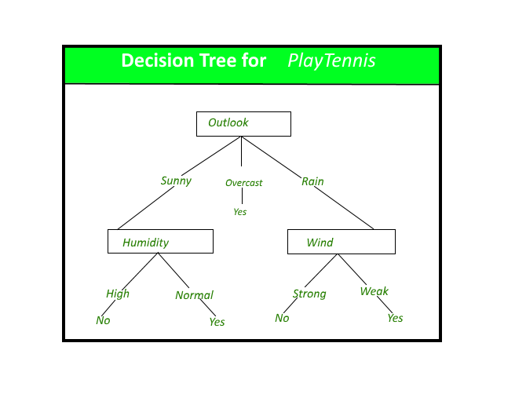
Decision Tree
It is a type of supervised learning algorithm that is mostly used for classification problems, but it works for both categorical and continuous dependent variables.
This model takes an instance, traverses the tree, and compares important features with a determined conditional statement.
Let us understand by taking an example of pass/fail ,We give marks and value 0 if fail and 1 if pass , to Decision Tree algorithm and call the fit method,a model will be formed.
Then we will give a marks to the model for which pass/fail is to be predicted,and call the predict method ,we get the output.

Slide 42
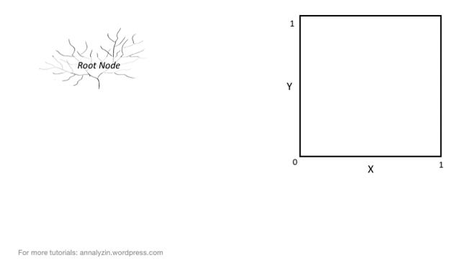
Decision Tree

Slide 43
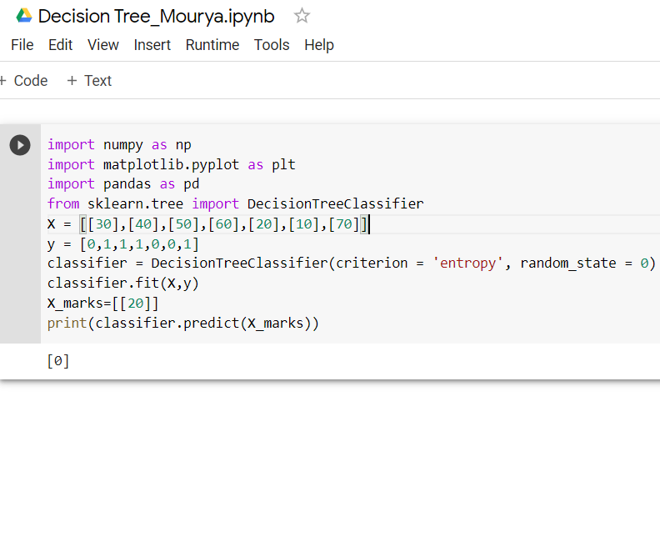
Implementation of Decision Tree
First we'll call Decision Tree algorithm ,then we give marks and its weight as the input .
The value of X( marks) is 20 .
The Predicted value of Y (Pass/Fail) is 0.
So if the marks is 20 then the student is said to Fail.

Slide 44
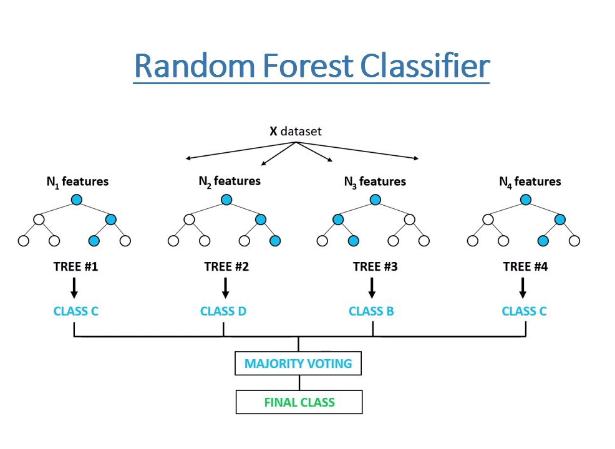
Random Forest
A random forest is an ensemble of decision trees. In order to classify every new object based on its attributes, trees vote for class- each tree provides a classification. The classification with the most votes wins in the forest.
Let us understand by taking an example of pass/fail ,We give marks and value 0 if fail and 1 if pass , to Random Forest Regressor algorithm and call the fit method,a model will be formed.
Then we will give a marks to the model for which pass/fail is to be predicted,and call the predict method ,we get the output.

Slide 45
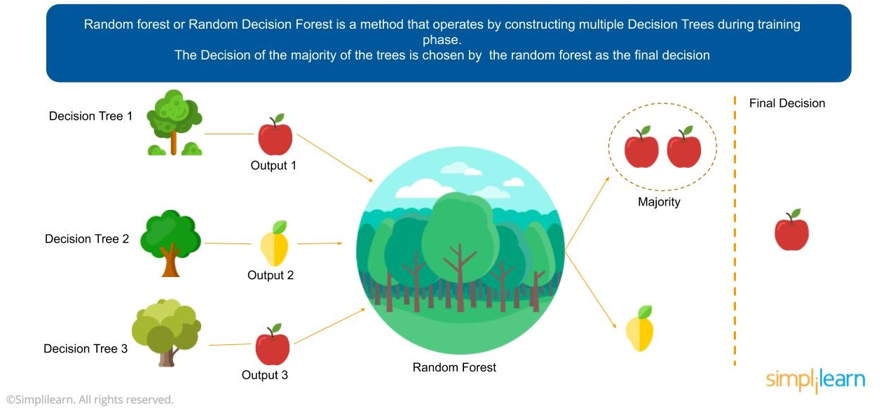
Random Forest

Slide 46
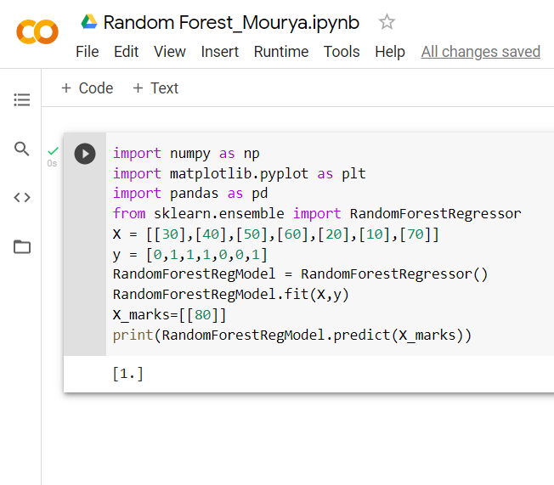
Implementation of Random Forest
First we'll call Random Forest Regressor algorithm ,then we give marks and its weight as the input .
The value of X( marks) is 80 .
The Predicted value of Y (Pass/Fail) is 1.
So if the marks is 80 then the student is said to Pass.

Slide 47
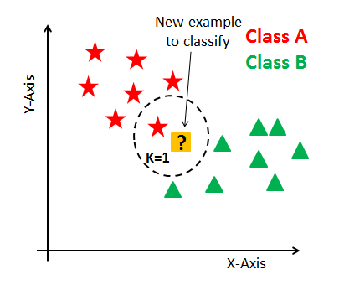
KNN (K-Nearest Neighbors)
It can be used for both classification and regression problems. However, it is more widely used in classification problems in the industry.
K nearest neighbors is a simple algorithm that stores all available cases and classifies new cases by a majority vote of its k neighbors.

Slide 48
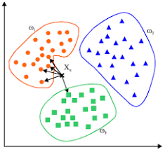
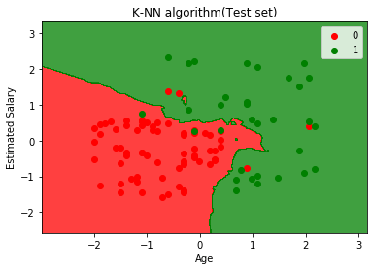
KNN (K-Nearest Neighbors)

Slide 49
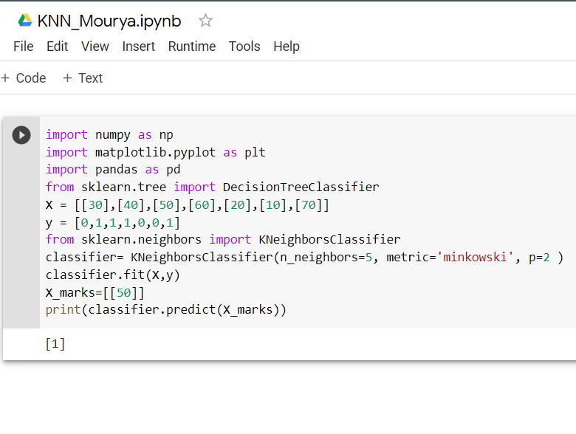
Implementation of KNN
Let us understand by taking an example of pass/fail ,We give marks and value 0 if fail and 1 if pass , to KNeighbors Classifier algorithm and call the fit method,a model will be formed.We can give the number of neighbours present here.
Then we will give a marks to the model for which pass/fail is to be predicted,and call the predict method ,we get the output.
The value of X( marks) is 50 .The Predicted value of Y (Pass/Fail) is 1 . So if the marks is 50 then the student is said to Pass.

Slide 50
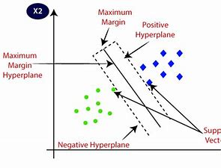
SVM (Support Vector Machine)
Support Vector Machine or SVM is used for Classification as well as Regression problems.
The goal of the SVM algorithm is to create the best line or decision boundary that can segregate n-dimensional space into classes .The best decision boundary is called a hyperplane.
SVM chooses the extreme points/vectors that help in creating the hyperplane. These extreme cases are called as support vectors, and hence algorithm is termed as Support Vector Machine.

Slide 51
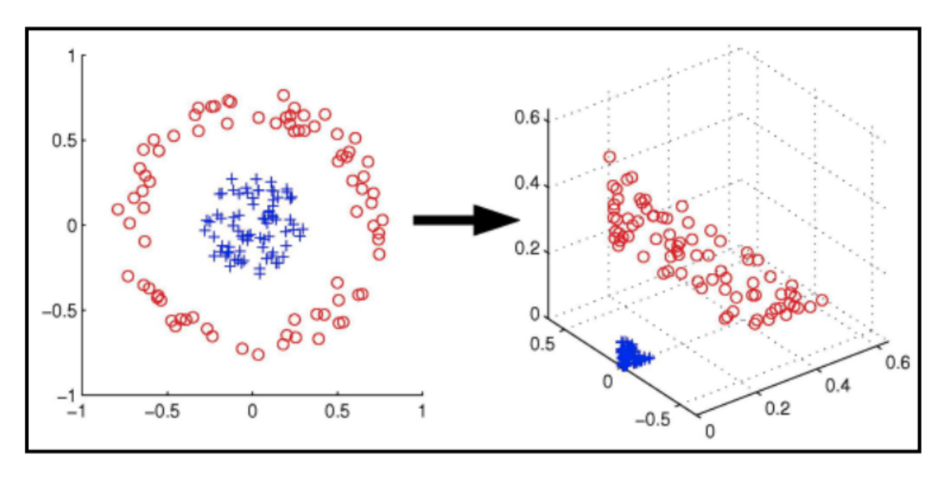
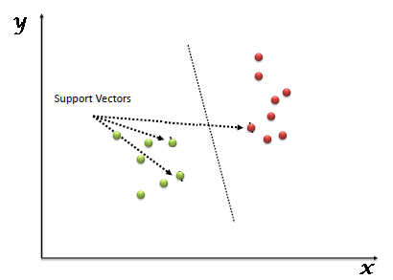
SVM (Support Vector Machine)

Slide 52
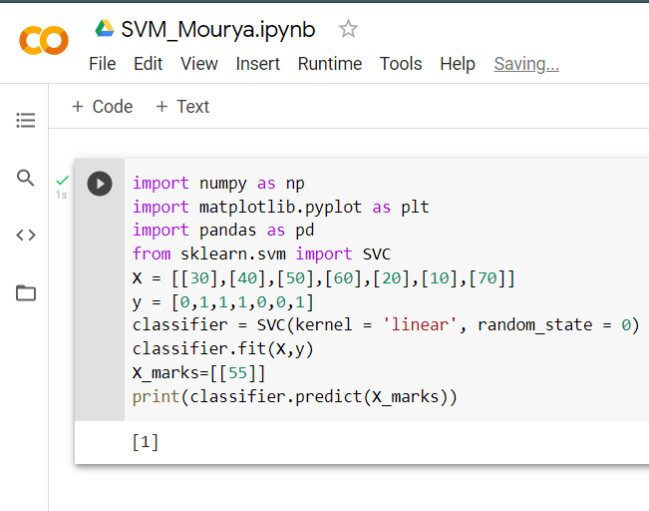
Implementation of SVM
Let us understand by taking an example of pass/fail ,We give marks and value 0 if fail and 1 if pass , to SVC algorithm and call the fit method,a model will be formed.
Then we will give a marks to the model for which pass/fail is to be predicted,and call the predict method ,we get the output.
The value of X( marks) is 55 .The Predicted value of Y (Pass/Fail) is 1 . So if the marks is 55 then the student is said to Pass.

Slide 53
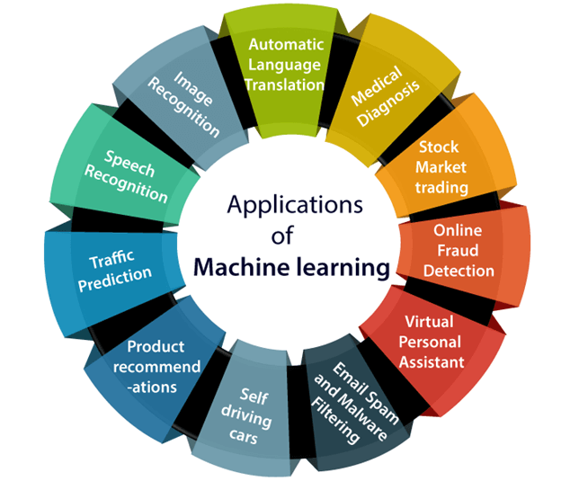
Application of Machine Learning

Slide 54
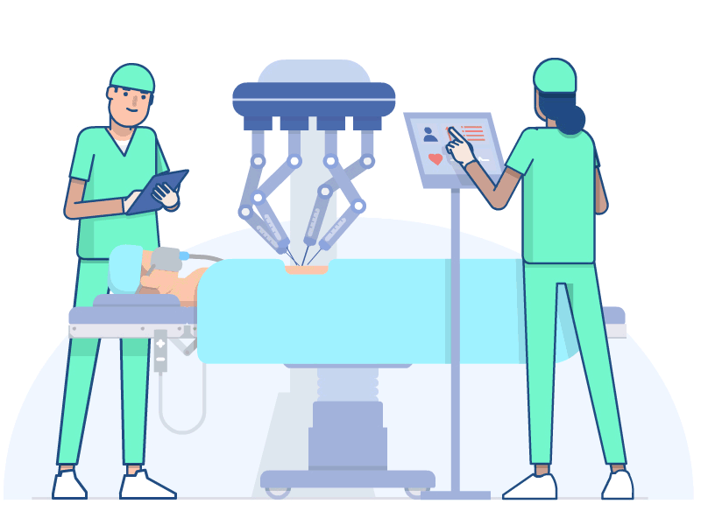
Application of Machine Learning

Slide 55
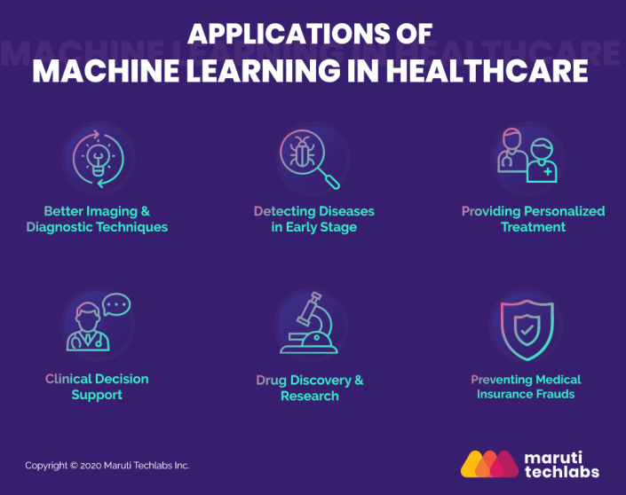
Application of ML in Health Care

Slide 56
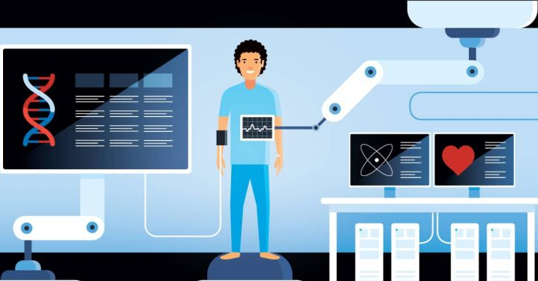
Application of ML in Health Care
Machine learning applications can potentially improve the accuracy of treatment protocols and health outcomes through algorithmic processes.
Faster processing speeds and cloud infrastructures allow machine learning applications to detect anomalies in images beyond what the human eye can see, aiding in diagnosing and treating disease

Slide 57

Application of ML in Health Care

Slide 58

Application of ML in Telecom

Slide 59

Application of ML in Telecom
Customer service chat bots – Automating customer service inquiries, routing customers to the proper agent, and routing prospects with buying intent directly to sales people .

Slide 60


Slide 61

Application of ML in Telecom
Speech and voice services for customers – Allowing customers to explore or purchase media content by spoken word rather than remote control

Slide 62


Slide 63

Application of ML in Telecom
Predictive maintenance – The ability to fix problems with telecom hardware (such as cell towers, power lines, etc) before they happen, by detecting signals that usually lead to failure .

Slide 64


Slide 65
Conclusion
Machine Learning is a technique of training machines to perform the activities a human brain can do, a bit faster and better than an average human-being.
Machines can be trained to perform human activities in several areas and can aid humans in living better lives.

Slide 66
THANK YOU

